Slide 1

SMART INDIA HACKATHON 2026
Problem Statement ID – SIH2026171
Problem Statement Title - On-Device Visual Perception for Light-weight Browser Agent
Theme - Smart Automation
PS Category - Software
Team ID -
Team Name – The Honoured Ones
.

Slide 2














ANTARDRISHTI
THE PROBLEM : AI AGENTS NEED TO SEE—BUT SHOULD NOT SEE EVERYTHING
AI browser agents can visually understand and operate our websites. But raw screen content can contain sensitive information, while DOM-only approaches cannot capture everything users actually see.
PRIVACY EXPOSURE
VISUAL BLIND SPOTS
THE LOCALITY TRADE-OFF
P01
Screens can contain sensitive information such as credentials, financial data, private documents.
P02
DOM-only agents can miss canvas, images, PDFs, visual overlays, and rendered content.
P03
Full visual reasoning on constrained devices can be computationally expensive, while sending raw visual content to remote AI creates privacy risk.
A browser-native privacy firewall that combines screen + DOM + ARIA perception,
Detects sensitive content locally, precisely redact/tokenizes it, and exposes only sanitized context to remote AI reasoning, while having guardrails and egress gate protection
KEY INNOVATION
DESIGNED AROUND GIVEN CRITERIA
TARGET USERS
(P03)
01 Privacy-preserving context (P01)
Detect → redact / tokenize → preserve intent
VISUAL CONTEXT ACCURACY
PII DETECTION
REDACTION PRECISION
CLIENT RESOURCES
END-TO-END LATENCY
STUDENTS & RESEARCHERS
05.Event + Risk Router
SECURED AI-ASSISTED BROWSING
02 Multimodal perception (P02)
Screen + DOM + ARIA → unified local scene
PROFESSIONALS
CONFIDENTIAL WORKFLOWS
03 Verified egress boundary
Independent verification → fail closed
ENTERPRISE TEAMS
04 Local execution
Browser verifies actions
CONTROLLED BROWSER AUTOMATION

Slide 3
.
Technical Approach
Software :
Flow Chart :
Chrome & Firefox Web Extension (MV3)
JavaScript / TypeScript
ONNX Runtime Web + Transformers.js
WebGPU with WASM fallback
Local OCR + visual detection
DOM + ARIA / Accessibility Tree
Python backend + LLM/VLM
Secure token vault + policy engine
LOCAL PERCEPTION + PRIVACY
ON-DEVICE PRIVACY BOUNDARY
2
REMOTE REASONING
EVENT + RISK
LOW • DOM / A11Y
ONLY SANITIZED DATA
1
DOM
A11Y
SCREEN
ROUTER
MED • OCR + CV
EGRESS
GATE
CLOUD REASONER
page / UI change → re-evaluate
NO RAW PII
HIGH • ViT / VLM
ALLOW ONLY
SANITIZED
LLM / VLM
planning + reasoning
3
UNIFIED SCENE GRAPH
4
5
6
PRIVACY ENGINE
TOKENIZE
+ REDACT
SANITIZED
STATE
FAIL CLOSED
PII • faces • secrets
3
RAW PRIVATE PIXELS + VALUES NEVER CROSS THE BOUNDARY
Models :
ACTION PLAN
Florence-2-base: grounding & OCR
MediaPipe: face detection
DBNet/PaddleOCR + GLiNER: text/PII detection
Server-side open-weight LLM/VLM: reasoning
7. REMOTE PLAN RETURNS → LOCAL POLICY CHECK → LOCAL EXECUTION
ACTION PLAN
tokens + capabilities
tokens + capabilities
page / UI change → re-evaluate locally
RETURN TO → LOCAL
REAL BROWSER
EXECUTION ADAPTER
ACTION SAFETY GATE
LOCAL TOKEN VAULT
DOM / A11Y
WebMCP*
<EMAIL_07> → value
default
optional
resolve
DOM/A11y = universal path • WebMCP = optional
.
3
.

Slide 4
.
Feasibility & Viability
.
Technical Feasibility :
RISK | MITIGATION
Limited browser compute | Event-driven + ROI-based inference
Missed PII / faces | Multi-stage detection + conservative policy
Latency | Cascade models + cached scene state
Privacy leakage | Verified egress gate; fail closed
Browser-native execution — Chrome/Firefox extension with WebGPU + WASM fallback.
Lightweight perception — DOM/A11y first; CV/OCR/VLM invoked only on changed or high-risk regions.
Privacy enforcement — PII/faces detected locally, tokenized/redacted before network egress.
Fail-closed security — No uncertain or unsanitized content leaves the browser.
Viability :
Resource Viability
Scalability
Uses open-source/open-weight models.
Browser-side inference avoids continuous cloud image transmission.
Server handles computationally heavy reasoning.
Same privacy layer can work across websites.
DOM/A11y provides low-cost universal coverage.
Vision is activated only when required.
.
4

Slide 5
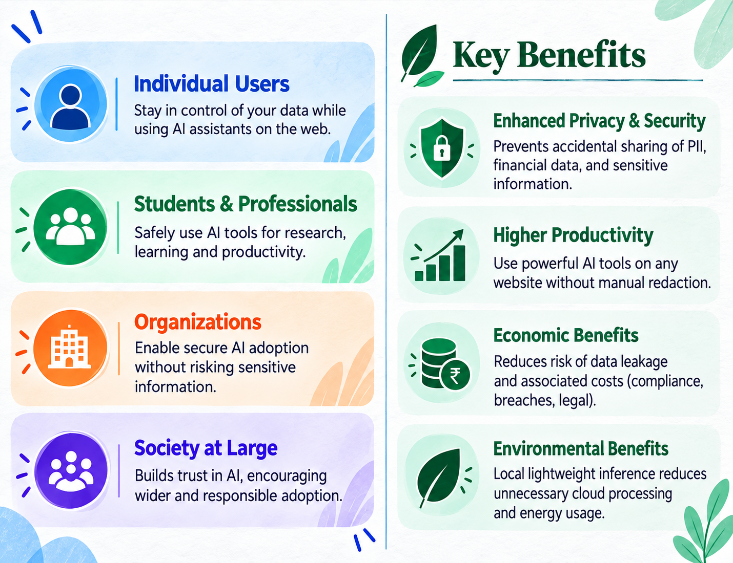
.
Impact & Benefits
.
Evaluation Metric | Existing | ANTARDRISHTI (Enhancement)
Visual context accuracy | Cloud/desktop GUI agents | Local multimodal scene understanding
PII precision & recall | WebRedact baseline | Multi-stage local detection
Redaction precision | Existing visual redactors | Policy-controlled redaction
Client resource usage | Host/cloud processing | Browser WebGPU/WASM
E2E latency | Screenshot → cloud → action | Event-driven local →sanitized →cloud→ action
.
5

Slide 6
.
Research & Analysis
.
PROBLEM & GAP:
Scattered Solutions:
Raw screenshots expose PII to remote GUI agents.
DOM-only perception misses canvas, images, video, PDFs, iframes & visual overlays.
Privacy protection must preserve task-relevant visual context.
GUIGuard: privacy recognition → protection → task execution
PrivWeb: local LLM-based interface anonymization
CAPED: task-aware selective screenshot exposure
WebPII/WebRedact: visual PII detection & redaction
Research:
GUIGuard — Privacy-Preserving GUI Agents
Research:
PrivWeb — CHI 2026 ; CAPED — arXiv ; WebPII — arXiv
BENCHMARK: (Published results)
Our Research:
Browser-native privacy boundary
WebRedact: 0.753 mAP@50 at ~20 ms CPU.¹
CAPED: seeded leakage reduced 0.766 → 0.268.²
GUIGuard: privacy recognition remains a major bottleneck.³
Sema: 130–210× lower screenshot uplink, ≤0.7 pp accuracy loss.⁴
DOM + A11Y+Vision
Unified Scene understanding
Local PII Detection + Tokenization
Verified Egress Gate
Sanitized Context
Research:
WebPII / WebRedact ·CAPED ·GUIGuard ·Sema
Remote Agent
.
6

